Slide 1
Hanover High School
Athletics
June 17, 2020

Slide 2
Fall Sport Offerings
Boys:
Soccer (2)
Cross Country (1)
Football (3)
Golf (2)
Girls:
Soccer (2)
Cross Country (1)
Field Hockey (3)
Cheerleading (2)
Volleyball (3)

Slide 3
Winter Sport Offerings
Boys:
Basketball (3)
Hockey (2)
Skiing* (1)
Swimming* (1)
Track & Field (1)
Wrestling* (1)
Girls:
Basketball (3)
Hockey* (1)
Skiing* (1)
Swimming* (1)
Track & Field (1)
Gymnastics (1)
Dance (1)
* - MIAA Approved Cooperative Team

Slide 4
Spring Sport Offerings
Boys:
Lacrosse (2)
Track & Field (1)
Baseball (2)
Tennis (1)
Rugby (2)
Girls:
Lacrosse (2)
Track & Field (1)
Softball (2)
Tennis (1)

Slide 5
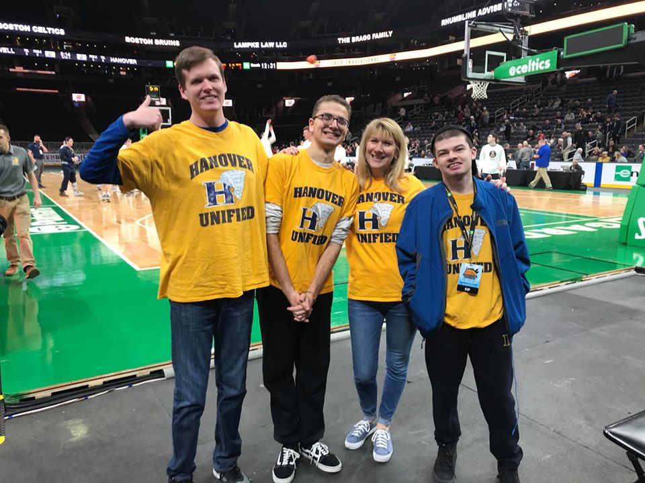
Unified Sports
Offerings
Soccer
Basketball
Kickball
Opponents
Abington
Marshfield
Rockland
Andrew James Lawson Foundation Invitational

Slide 6
Participation
2016-2017 2017-2018 2018-2019 2019-2020
Fall 379 (47%) 402 (50%) 401 (50%) 387 (50%)
Winter 241 (30%) 264 (33%) 284 (35%) 272 (35%)
Spring 304 (38%) 337 (42%) 327 (40%) N/A
Through the winter season approximately 64% of the student body participated in an MIAA sport or MSAA athletic activity.
In the summer of 2019
greater than 220 students participated in the
HHS Athletic Strength & Conditioning program.

Slide 7
Team Recognitions
Fall 2019
Patriot League Championships
Girls Cross Country, Girls Soccer, Cheerleading
MIAA Academic Excellence Awards
18 out of 18 teams

Slide 8
Team Recognitions
Winter 2019 -2020
Patriot League Championships
Boys Hockey, Gymnastics
MIAA Academic Excellence Awards
15 out of 15 teams

Slide 9
Team Recognitions
Winter 2019 - 2020
MIAA Championship
Boys Hockey - Division 3 State Champions

Slide 10
Individual Recognitions
South Sectional Champion - Wrestling
Jack Long (2x), Tomás McDonough, Griffin Pithie
Patriot League – MVP
Girls Soccer – Dot Tilden
Boys Hockey – Manning Morris
Girls Cross Country – Audrey Wheeler
Girls Swim & Dive – Sarah Gavin
Gymnastics – Kayleen Boutin

Slide 11
Recognition
HHS Sports Boosters
Well over a decade of service to HHS Athletics, the current booster group is “graduating.”
Lori Shisler, Bernadette O’Connor, Ed Alicea, and numerous other Members at Large sacrificed early mornings, late evenings, holidays, and everything between to support the students of HHS.
Supported purchases of equipment, scholarships, school and community events.

Slide 12
HHS Athletic Goals
2020-2021 Goals…Expectations
Maintain a participation rate of 70%
Continue to foster community engagement
Improve overall athletic conditioning and wellness

Slide 13
HHS Athletic Goals
2020-2021 Goals
Formulate a new HHS Athletic Booster Organization
Institute a Hanover High School Athletic Hall of Fame
Increase HHS Athletic involvement with the MIAA

Slide 14
HHS Athletic Goals
Formulating a new HHS Athletic Booster Organization
Spring 2020 – Solicit Board Members
Summer 2020 – Develop Policies and Bylaws
Fall 2020 – Promote and Implement New Organization

Slide 15
HHS Athletic Goals
Hanover High School Athletic Hall of Fame
Summer 2020 – Formulate HOF Selection Committee
Fall 2020 – Formulate HOF Nomination and Selection Process
Spring 2021 – Accept Nominations for the 2021 Class of HOF Inductees
Fall 2021 – Host Inaugural HHS Athletic HOF Class

Slide 16
HHS Athletic Goals
HHS Athletic involvement with the MIAA
Summer 2020 - Apply for various Committee Vacancies

Slide 17
Continued Thanks to the following for helping Hanover High School Athletics achieve the current level of success.
Student-Athletes
HHS Sports Boosters
HHS Athletics Staff
HPS Administration
Parents & Community
Town Departments
Youth Organizations
Local Businesses

